Slide 1
Preparing Postsecondary Students for Success
Senate Education Committee
October 23, 2017

Slide 2
FLORIDA COLLEGE SYSTEM MISSION AND ENROLLMENT
STUDENT SNAPSHOT
The Florida College System continues to fulfill its historic mission:
Providing access to postsecondary education in the state through a comprehensive variety of programs which address multiple needs.
Providing a cost-effective and efficient avenue for raising the educational and economic well-being of the state.
Being the access point for students into postsecondary education and through the 2+2 articulation agreement to the State Universities.
Expanding postsecondary access and demonstrated its flexibility and responsiveness to the state and its citizens, by developing workforce oriented baccalaureate degrees per Legislative authorization.
Supporting linking business and industry needs to the strategic growth of high quality, affordable, postsecondary educational opportunities.
2
Notes:
Note: Florida is number 1 in SREB certificate and degree rankings when we include baccalaureate degrees awarded. Otherwise, the latest data show that TX awarded more certificates.
Updated: 01/27/17

Slide 3
FLORIDA COLLEGE SYSTEM OVERVIEW
3

Slide 4
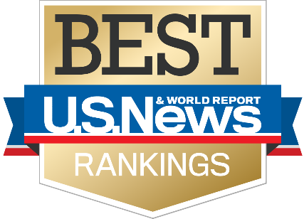
NATIONAL RECOGNITIONS
#1 State in Country for Higher Education
#1 Producer of Associated Degrees and Certificates among southern states
14 Florida Colleges in Aspen’s Top 150
#4 Community College System
4

Slide 5
STUDENT SNAPSHOT
Student Characteristics | Fall 2016
5
Notes:
Fall 2016 College Credit Student Demographics:
59% female students
58% minority enrollment
Average student age is 25
This comes from the Points of Interest page of the Fact Book. Updated July 2017.
2015-16 figures from updated Data Snapshots (January 2017).

Slide 6
THE SMART CHOICE
A Pathway for Florida’s High School Graduates | 2013-14
out of
3
every
5
standard high school diploma recipients in 2012-13 enrolled
in Florida higher education
in 2013-14.
…of these
65.7%
enrolled in a Florida College System institution.
6
Notes:
Over 50% of upper division students in the SUS came from FCS institutions (either completed an AA or transferred).

Slide 7
PLACEMENT & WORKFORCE EARNINGS
95% of 2014-15 FCS graduates are continuing their education or working the year after graduation, with an average full-time wage of $42,500.
9 out of 10 graduates are continuing education or employed in Florida.
Source: Florida Department of Education, Florida Education & Training Placement Information Program (FETPIP)
7

Slide 8
STUDENT SNAPSHOT
STUDENT SNAPSHOT
Student Enrollments | 2015-16
#1 in award rankings
Florida is the No. 1 certificate and degrees producer among Southern states affiliated with the Southern Regional Education Board
(SREB State Database Exchange, 2016)
8
Notes:
Note: Florida is number 1 in SREB certificate and degree rankings when we include baccalaureate degrees awarded. Otherwise, the latest data show that TX awarded more certificates.
Updated: 01/27/17. Data come from comparing Points of Interest table, and only comparing the programs listed in the slide.

Slide 9
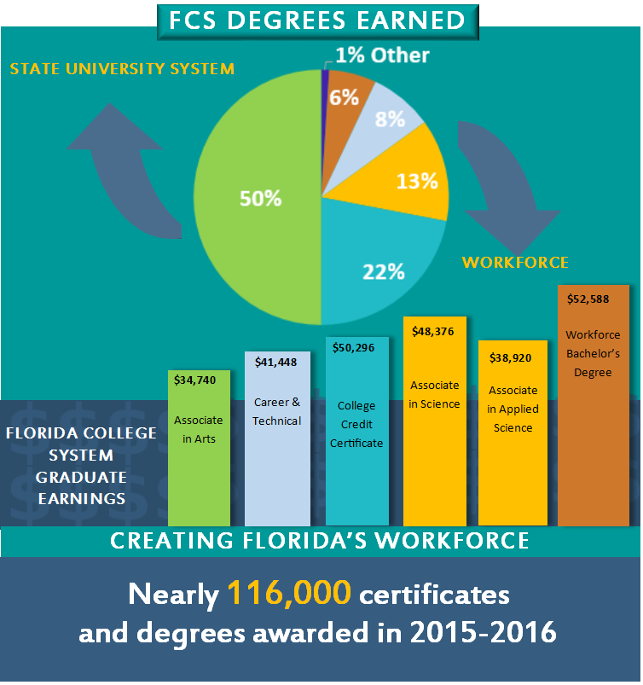
GATEWAY TO THE WORKFORCE
Source: PK-20 Education Reporting & Accessibility (PERA) and FCS Research & Analytics
9

Slide 10
Building on Excellence
Dr. Tom LoBasso, President Daytona State College

Slide 11
COLLEGE PRIORITIES
Implementing Student Success Initiatives.
Accelerating completion through dual enrollment partnerships.
Aligning workforce programs to local and statewide employer needs.
Redesigning Math pathways.
Articulating targeted pathways with SUS.
11
Notes:
COP LBR
2018 Legislative Priorities
Request: (Recurring) Goal
$80 million for performance-based funding
(includes $40 million state investment and
$40 million institutional investment) Continue strategic improvements in areas of job placement and continuing education, retention and completion rates, and wage earnings.
$14 million for industry certifications Expand the number of nationally recognized high-value certificates that address areas of critical workforce need in emerging or targeted industries.
$75 million for Workforce Preparation Increase degree and certificate programs to fulfill identified employment gaps in high-demand areas.
$67 million for Student Success and Completion Establish program-specific “2+2” targeted pathways and shorten time-to-degree completion by investing in services, including mental and behavioral health, to promote student success, persistence, and retention.
$50 million for Faculty Recruitment and Retention Recruit and retain high quality faculty and staff, with focus on competitive fields, including STEM.

Slide 12
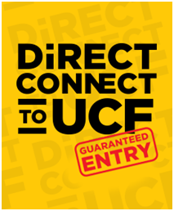
2+2 Articulation
Direct Pathway for Students
Florida College System institutions have worked with the State University System to expand partnerships with the universities.
In fact, Florida College System institutions partner with state universities to offer 57 targeted 2+2 articulation agreements.
These partnerships ensure that students have clear access to transfer and enroll into a partner one of many partner universities,
Currently, 28 of 28 Florida College System institutions have targeted pathway agreements with a SUS partner.
16
10
Notes:
Partnerships:
Santa Fe College to University of Florida
Golden Guarantee Program: Tallahassee Community College to Florida State University
Direct Connect to USF: College of Central Florida; Daytona State College; Eastern Florida State College; Lake-Sumter State College; Seminole State College of Florida and Valencia College
FUSE: Hillsborough Community College; St. Petersburg College guaranteed admission to USF
Florida’s strong “2+2” articulation policies and common state course numbering system help provide a pathway for Florida College System (FCS) graduates transfer to a State University System of Florida (SUS) institution.
Overarching Questions
What is the purpose of the state’s articulation policy?
Why is it important?
Is it working?
What can be done to identify and stop the leaks in the pipeline?
Guiding Questions
To what extent are FCS AA graduates applying to, being admitted, and enrolling at state universities?
For those who apply and are not admitted, what are the barriers or issues? Where do they end up?
For those who are admitted to a state university and do not enroll, where do they go?
Where are the leaks in the articulation pipeline? What can we do to keep more students on track for a bachelor’s degree?
How successful are FCS transfers? Do they graduate on time?
What can we do to support AS students who wish to attend a state university? What are the barriers to AS to BS articulation?
What are the employment and wage outcomes of students who transfer and earn a degree at a state university? Are they different from native university students?

Slide 13
AA COMPLETER TRANSITION
Applied to SUS
35,326 students
Accepted to SUS
30,107
Enrolled in SUS
25,092
83.3% of accepted students
85.1% of students who applied
AA Graduates
55,132
64% of FCS AA graduates
Half of juniors & seniors at Florida’s state universities
came from the Florida College System.
Source: State University Database System (2016). Analysis by Board of Governors staff and Division of Florida Colleges staff.
13
Notes:
55,132 FCS AA completers in 2013-14. A large proportion of FCS students who apply to a state university are admitted and register for classes. In 2014-15, over 35,000 FCS students applied for the SUS, with over 85% (30,107) being accepted. Of these admitted students, over 80% (25,092) enrolled. What is not yet understood is why nearly 10,000 AA graduates a year who applied to a SUS institution do not subsequently enroll in one. Despite this articulation gap, which is partially but not fully explained in Figure 3, FCS students make up a substantial portion of SUS undergraduate student body.
*71% of students who applied to the SUS subsequently enrolled
For 2013-14 FCS graduates, 73% continued their education:
*47% continued their education in the SUS
*22% continued their education in the FCS
*3% continued their education in Private Institutions
*1% continued their education in District Postsecondary
For 2013-14 FCS graduates, around 20% were found employed and not continuing their education. FCS AA completers earned an average annualized wage of $36,433, which was $3,000 more than AA leavers, and over $12,500 more than recent high school graduates in 2013-14.

Slide 14
FLORIDA COLLEGE SYSTEM GRADUATES TRANSFER TO THE STATE UNIVERSITY SYSTEM TO BACCALAUREATE DEGREES
THE SMART CHOICE
25,092 FCS Students Enrolled (2013-2014)
…of these
enrolled in a Florida College System institution.
Source: FCS Articulation Table 7 using SUS student data course files. Figures represent any FCS student found in the SUS in Fall 2014 (i.e., all associate degrees and those who transferred without a degree).
14

Slide 15
2 + 2 Articulation
Comparing GPAs, FCS transfer students perform as well as SUS native students: FCS AS – 3.17, FCS AA – 2.94, Native SUS – 3.12.
Sources: FCS Articulation Table 14 and 15 using SUS student data course files. Fall 2014 enrollment for SUS majors. State University Database System (2016). Analysis by Board of Governors staff and Division of Florida Colleges staff.
15
Notes:
BOG Program of Strategic Emphasis. The BOG documentation has it more detailed to the CIP, which we don’t have.
http://www.flbog.edu/pressroom/strategic_emphasis/

Slide 16
SUCCESSFUL RELATIONSHIPS WITH UNIVERSITIES
Joint use partnerships
APPRISE
Maintaining 2+2 and college mission of open access
Serving different populations
Offering different degrees
Developing targeted articulation agreements
2+2 Policies
FCS/SUS Relationships
Statewide Common Course Numbers
Shared/ Joint Use
Reverse Transfer
All FCS baccalaureate degree programs are modeled from the 2+2 program. Students earn their Associates degree before moving into a baccalaureate program.
16

Slide 17
Advisement: Guided Pathways
Madeline Pumariega, Chancellor, Florida College System

Slide 18
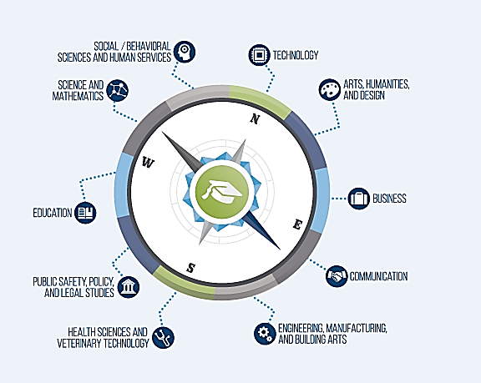
HELPING STUDENTS STAY ON THE PATH
Entire Institutional Redesign: A Student-Centered Approach
Increased Collaboration
Increased Engagement
Alignment of policies, practices, and business processes
Intrusive Advisement Implementation
Mandatory Advisement
Meta-Majors
Guided Pathways Programs
At-Risk Monitoring and Support
Academic Success Centers
Courses Flagged
Course Scheduling with students in mind!
Align course scheduling with academic plan
Once in a meta-major, help students narrow their study to a major

Slide 19
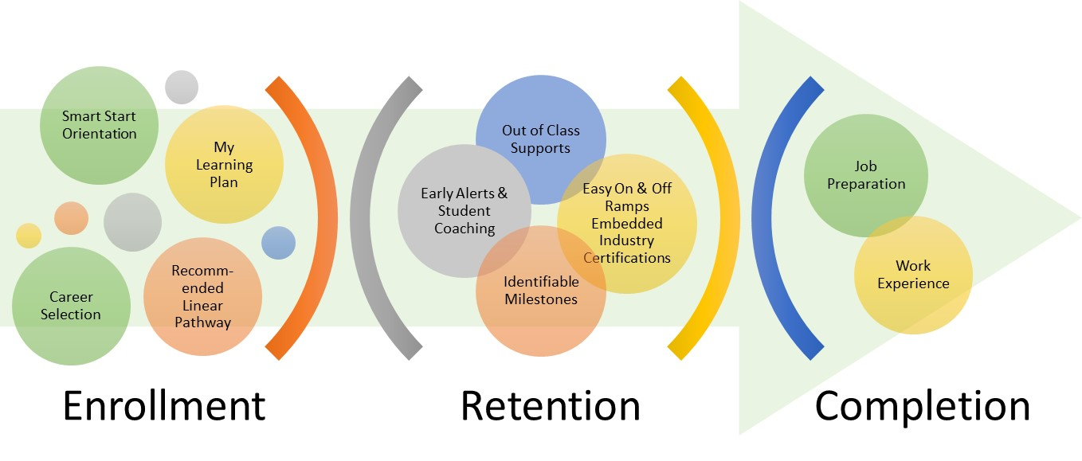
SMART-START FINISH MODEL
Smart-Start Finish-Strong Model
Transfer Ready
JTC
St. Petersburg College 2017
19
Notes:
Focus on the end goal
Align programs with career path jobs of economic importance
All students need workforce skills
Integrate employment information into programs
Assess Market Value of your programs and certificates

Slide 20
GUIDED PATHWAYS PRACTICE AREAS
Support students beginning “with the end in mind”
from first contact until employment or transfer.
20
Notes:
Slide provided with permission from Melinda Karp at CCRC

Slide 21
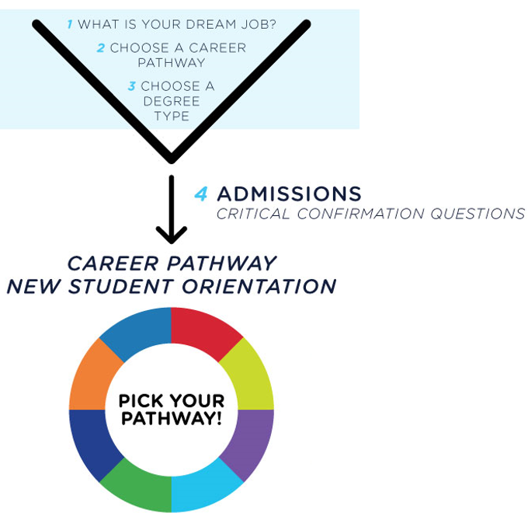
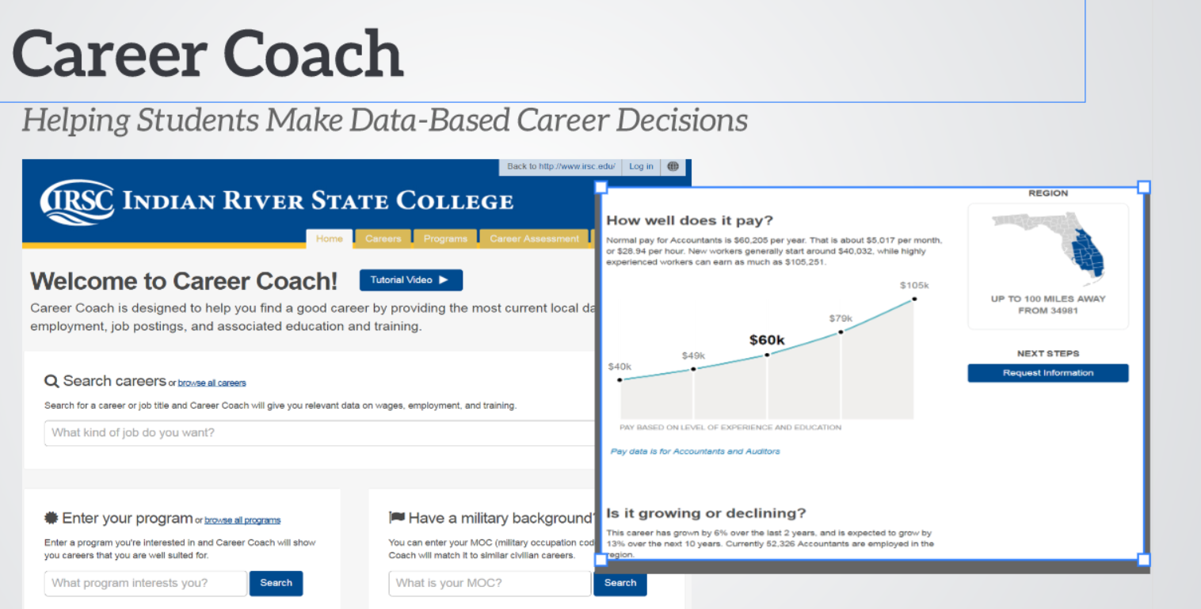
CLARIFY THE PATH
Detailed information on target career and transfer outcomes.

Slide 22
Instructional Strategies and Support

Slide 23
INSTRUCTIONAL STRATEGIES FOR DEVELOPMENTAL EDUCATION
Senate Bill 1720 (2013) reformed developmental education instruction.
Modularized developmental instruction that is customized and targeted to address specific skills gaps.
Compressed developmental instruction structures that accelerate student progression from developmental instruction to college-level coursework.
Contextualized developmental instruction that is related to meta-majors.
Co-requisite developmental instruction or tutoring that supplements credit instruction while a student is concurrently enrolled in a credit-bearing course.
23
Notes:
Institutions were required to offer developmental education courses using the instructional strategies listed below:
Modularized developmental instruction that is customized and targeted to address specific skills gaps. For example, colleges offers courses that are technology-based and self-paced. Course material is deduced into sub-unit parts and condensed into component pieces that address precise skill area deficiencies. Students will take a diagnostic test to determine which competencies have not been mastered and a student plan is then developed.
Compressed developmental instruction structures that accelerate student progression from developmental instruction to college-level coursework. Course delivery is more intense, and courses are offered in a variety of shortened timeframes to allow students to progress quickly.
Contextualized developmental instruction that is related to meta-majors or guided pathways. Meta majors are a series of academic pathways that help students identify the appropriate gateway courses related to general academic pathway, such as health sciences, education, and business.
Co-requisite developmental instruction that supplements credit instruction while a student is concurrently enrolled in a credit-bearing course. For example, a modularized course can be offered as a co-requisite course to English Composition or any of the entry-level, gateway courses.
Colleges were required to provide developmental education options, a minimum of two, to all students required to complete developmental education. Course credits for each strategy may vary.

Slide 24
STUDENT SUPPORT STRATEGIES
Comprehensive Advising Plan
Documented Student Achievement
Developmental Education Strategies
Description of Student Costs and Financial Aid Opportunities
Student Success Data Collection
Additional Components
24
Notes:
The developmental education implementation plan included 5 mandatory components and one optional area. The mandatory components were:
Comprehensive advising plan
Documented student achievements
Developmental education strategies
Description of student costs and financial aid opportunities
Student success data college; and
An optional section to include any additional programs or information related to Senate Bill 1720 the institution wanted to share. The following slides present an analysis of these plans to provide detail in terms of the information they contained.

Slide 25
STUDENT COURSE OUTCOMES FOR STUDENTS IN DEVELOPMENTAL EDUCATION COURSES (C OR ABOVE)
Source: PK-20 Education Reporting and Accessibility (PERA) Information Portal, Florida Department of Education
25
Notes:
Students in developmental reading and writing courses performed better than in developmental math courses with 74 percent, 73 percent, and 59 percent of students earning a grade of C or better, respectively.
According to the study on Administrators’ Perceptions of the Third Year of Developmental Education Reform in the Florida College System, colleges have made numerous changes to advising processes. Top highlights included the addition of more orientation resources online (78%), spent more time advising at-risk students identified through early alert systems (70%) and increased the duration of advising sessions (61%). The majority of institutions reported making staffing changes in response to the reform. Colleges tended to use fewer adjuncts and increased advising and orientation staff.
NOTE: The percentages included in the “Total or Average” column in Appendix B (Page 16) and displayed in Figure 1 (Page 5) measure an average of the rates of student outcome (e.g., “Grade C or Above”) for the four delivery strategies. This methodology is not weighted based on enrollment in the four separate developmental education strategies, but instead, treats the four delivery strategies equally (this is referred to as the mean of proportions). The percentages included in the slides, on the other hand, measure the proportion of all students earning a “Grade C or Above,” regardless of developmental education strategy for each subject area.

Slide 26
GATEWAY COURSE SUCCESS RATES (C OR ABOVE)
26
Notes:
From 2014-15 to 2015-16, increases in success rates were expressed for both English (71 to 73%) and Mathematics (66 to 67%), with decreases in the percentage of students who withdrew.

Slide 27
PANEL MEMBERS
Dr. Tom LoBasso
President of Daytona State College
Dr. James Richey
President of Eastern Florida State College
Dr. Lenore Rodicio
Executive VP and Provost, Miami Dade College
Dr. Avis Proctor
President of North Campus, Broward College
Dr. Christine Davis
VP for Student Affairs and Enrollment Management, Florida SouthWestern State College
Dr. Naima Brown
VP, Student Affairs, Santa Fe College
Madeline Pumariega
Chancellor, Florida College System

